Slide 1
Wellness Tracker
ICT934 · ASSESSMENT 3 · SEMESTER 2, 2026
Full-Stack Web Application Development
Prasana Lal Shrestha
Project Lead
Anjal Khadka
Database & Backend Integration
Rajib Adhikari
Documentation & Presentation
Notes:
Presenter: Prasana (suggested split — Prasana slides 1–6 & 15, Anjal 7–9, Rajib 10–14).
Welcome. We are presenting the Wellness Tracker, our full-stack web application for ICT934 Assessment 3. Introduce the three team members and their roles.

Slide 2






Project overview
One app to log and monitor five areas of daily wellness
Hydration
Sleep
Meditation
Activity
Appointments
Water intake in litres
Hours slept per night
Minutes per session
Exercise type & minutes
Upcoming health visits
OUR JOURNEY
01
Assessment 2
02
Assessment 3
03
Collaboration
Frontend-only React prototype with pages, forms and navigation
Expanded to full-stack: Node.js + Express API and PostgreSQL database
Frontend, backend, database, testing and docs
Notes:
Presenter: Prasana.
We built a full-stack wellness tracker covering hydration, sleep, meditation, activity and appointments. In Assessment 2 the app was frontend-only; for Assessment 3 we added an Express REST API and a PostgreSQL database so data persists per user. The work was split across three members.

Slide 3



Problem definition
Industry context
Operational problem
Our solution
Wellness behaviours are tracked with technology
Users rely on several disconnected trackers
Growing demand for one unified platform
Records logged separately or inconsistently
History is hard to reference and compare
No central dashboard to see trends over time
One secure place to store, review, edit and delete wellness data
Dashboard + history to show change over time
Responsive across devices
Notes:
Presenter: Prasana.
Industry: people track exercise, water, sleep, meditation and appointments in separate apps. Operationally that makes records inconsistent and history hard to compare. Target users are people recording daily health actions — they need something simple and secure; the dev team needs something maintainable and extensible. Our solution is a single, secure, responsive full-stack tracker.

Slide 4










Requirements summary
FUNCTIONAL REQUIREMENTS
NON-FUNCTIONAL REQUIREMENTS
Registration & login
Secure access to each user's own data
Secure
Hashed passwords, JWT-protected routes
CRUD operations
Create, read, update, delete across all modules
Responsive
Layouts adapt for tablet and mobile
Weekly analytics
Overview chart and goal progress
Reliable
Validated input; clear 400/401 errors
History pages
Review previously logged entries
Accessible
Linked form labels, ARIA roles, alerts
REST API
Frontend ↔ backend over RESTful endpoints
Scalable
Modular three-tier design for new features
Notes:
Presenter: Prasana.
Functional: register and log in, full CRUD for activity, hydration, sleep, meditation and appointments, weekly analytics, history pages, and REST communication. Non-functional: secure (hashed passwords, JWT), responsive layouts for tablet and mobile, reliable through backend validation with clear 400/401 errors, accessible (form labels linked to inputs, ARIA roles on dialogs, menus and alerts), and scalable. Constraint: React, Node.js, Express and PostgreSQL — developed on localhost:5000 and deployed to Vercel (frontend) and Render (API + database).

Slide 5
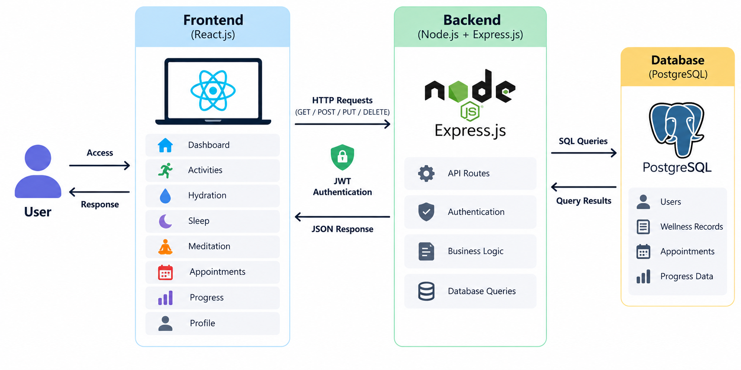




Full-stack architecture
Frontend
React + Vite
Backend
Node.js + Express
Database
PostgreSQL
BENEFITS
Separation of concerns
Maintainability
Live: React on Vercel → HTTPS + JWT → Express on Render → PostgreSQL on Render, JSON back to the UI
Clean data flow
Sources: Castilho (2023); Mamun (2021)
Notes:
Presenter: Prasana.
Three tiers. React handles pages, forms and client-side routing. A central api.js service sends GET/POST/PUT/DELETE requests with the JWT in the Authorization header, and turns any server error into a message the user can see. Express authenticates, validates and applies business logic, then queries PostgreSQL. Results return as JSON and React updates without a full page refresh. The app is live: the React build is hosted on Vercel and the Express API and PostgreSQL database on Render, all over HTTPS. Separating layers let us deploy the frontend and backend independently.

Slide 6
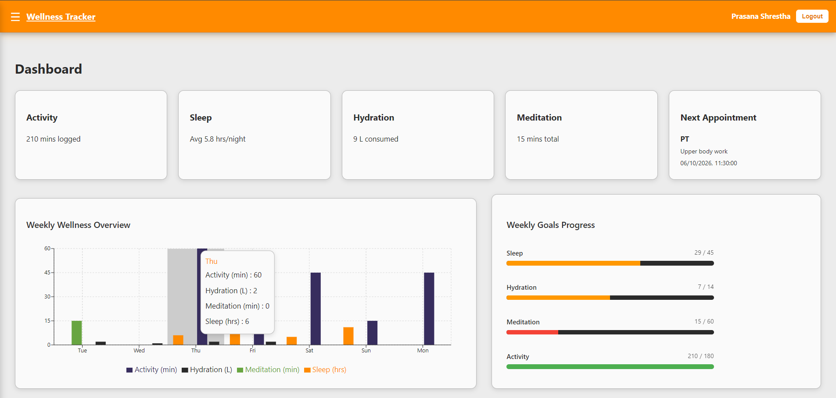




Frontend overview
TECHNOLOGIES
React 19
React Router v7
Context API
KEY FEATURES
Dashboard
Logging modules
History pages
Profile & weekly goals
Dashboard: summary cards, weekly wellness overview (hover for daily detail) and weekly goals progress
Progress charts
Source: Chen et al. (2019)
Notes:
Presenter: Prasana.
React gives reusable components shared across Activities, Sleep, Hydration and Appointments with a consistent look. React Router v7 handles client-side routing; Context API manages shared state such as the logged-in user. The orange header and light content areas keep the design consistent. Point out the weekly overview chart and weekly goals bars on the screenshot.

Slide 7





Backend overview
How every protected request is handled
Request
Authenticate
Validate
Business logic
Query
Respond
React api.js sends JWT in header
Verify JWT; bcrypt for passwords
Check submitted data
Apply CRUD rules
Read / write PostgreSQL
JSON back to the UI
TECHNOLOGIES
REST METHODS
Node.js
Express.js
REST API
JWT
bcrypt
GET
Read records
POST
Create entry
PUT
Update entry
DELETE
Remove entry
One language (JavaScript) on client and server
Source: Donham (2017)
Notes:
Presenter: Anjal.
The backend is Node.js with Express exposing RESTful routes for GET, POST, PUT and DELETE. For each protected request: the frontend sends the JWT in the Authorization header, Express verifies it, validates the input, applies business logic, queries PostgreSQL and returns JSON. Passwords are hashed with bcrypt. (Optional: add a Postman API test screenshot here if you have one — it was not included in the report.)

Slide 8
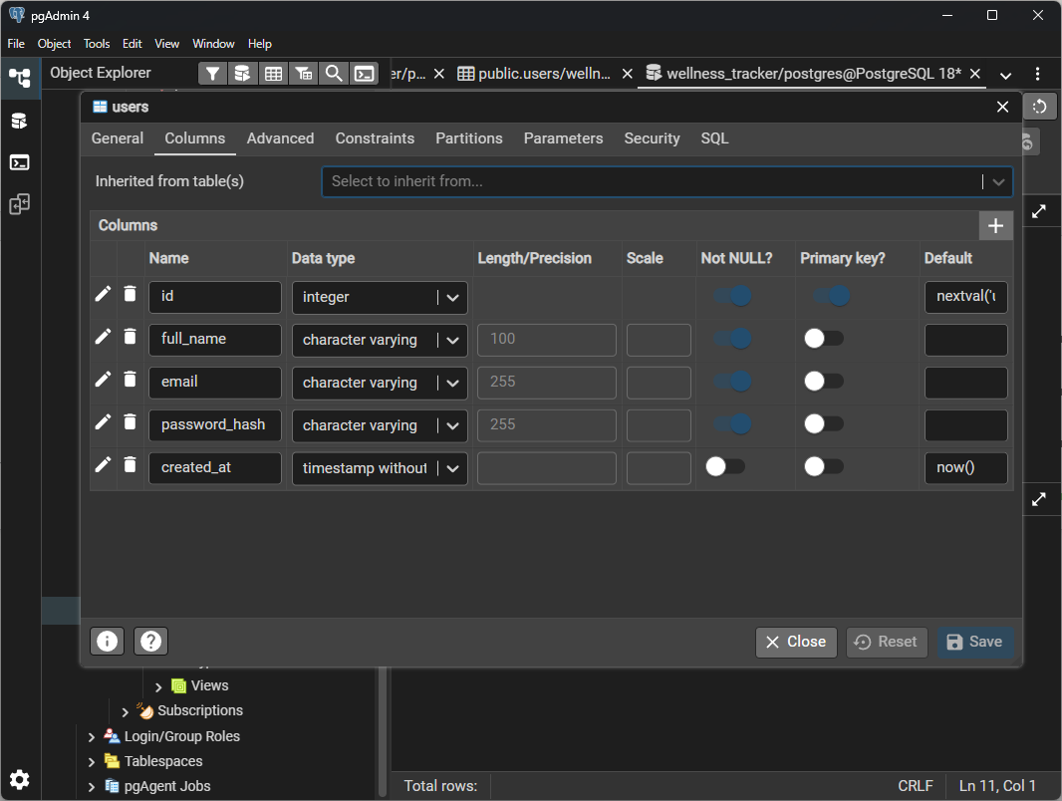




Database design
POSTGRESQL SCHEMA — 7 TABLES
users
user_settings
activities
appointments
hydration_logs
sleep_logs
meditation_logs
DESIGN FEATURES
Relational integrity Every record belongs to a user
Foreign keys user_id links logs to users
Indexed fields (user_id, date) indexes on every log table
users table in pgAdmin 4: id (PK), full_name, email, password_hash, created_at
Source: Urnikiene et al. (2026)
Notes:
Presenter: Anjal.
PostgreSQL was chosen because the data is structured and belongs to a user, and a relational database gives us integrity. The schema has seven tables: users, user_settings (weekly goals), activities, appointments, hydration_logs, sleep_logs and meditation_logs. Each log table carries a user_id foreign key, and each has an index on (user_id, date) because every list query filters by user and sorts by date. On start-up the server runs schema.sql and a migration check, so missing tables or columns are created automatically. Walk through the users table columns in the pgAdmin screenshot.

Slide 9

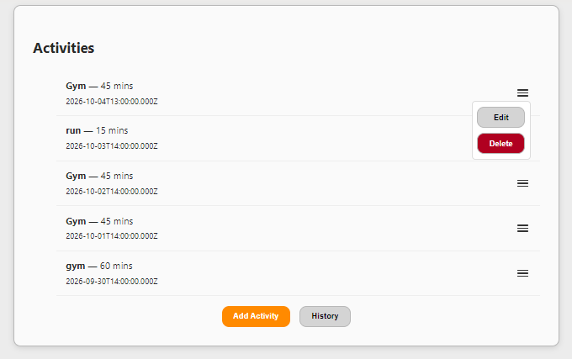



Key system features
Secure login & registration
Dashboard overview
CRUD on every module
Goals, progress & recommendations
Appointment scheduling
History pages
Profile editing
CRUD update: each entry has Edit (fix mistakes, reschedule) and Delete (remove past or unneeded entries)
Notes:
Presenter: Anjal.
Run through the features: secure login and registration, dashboard, CRUD on every module, weekly goals with progress bars, the Progress page (weekly summary, activity breakdown by type, and recommendations that compare this week's totals with the user's goals), appointment scheduling, history pages and profile editing. The screenshot shows the Activities page — each entry's menu opens Edit and Delete, and the UI refreshes immediately after a change.

Slide 10



Challenges & solutions
CHALLENGE
SOLUTION
Syncing frontend & backend
Central api.js that surfaces server errors
Live database had old / missing tables
Startup migration creates and repairs tables
Dates shifting a day across time zones
Dates kept as text; UTC for appointment times
Infinite fetch loop (Hydration page)
Dependency-safe useEffect
Deployment config (API URL, CORS, secrets)
Env-based config; secrets removed from Git
Notes:
Presenter: Rajib.
These are the real problems we hit, mostly when moving from localhost to the live deployment. 1) The frontend ignored failed responses, so a 500 looked like success — api.js now checks every response and shows the server's message. 2) The Render database had an old activities table with different columns and was missing others, causing 500 errors — the server now runs a migration on start-up that creates and repairs tables. 3) Dates moved by a day because PostgreSQL DATE values were converted using the server's time zone — dates are now returned as plain text and appointment times are sent in UTC. 4) The Hydration page hit an infinite fetch loop, fixed with a correct useEffect dependency array. 5) Deployment config: the API URL needed the /api path, CORS had to allow the Vercel domains, and the .env with secrets had been committed — config now comes from environment variables and .env is excluded from Git.

Slide 11



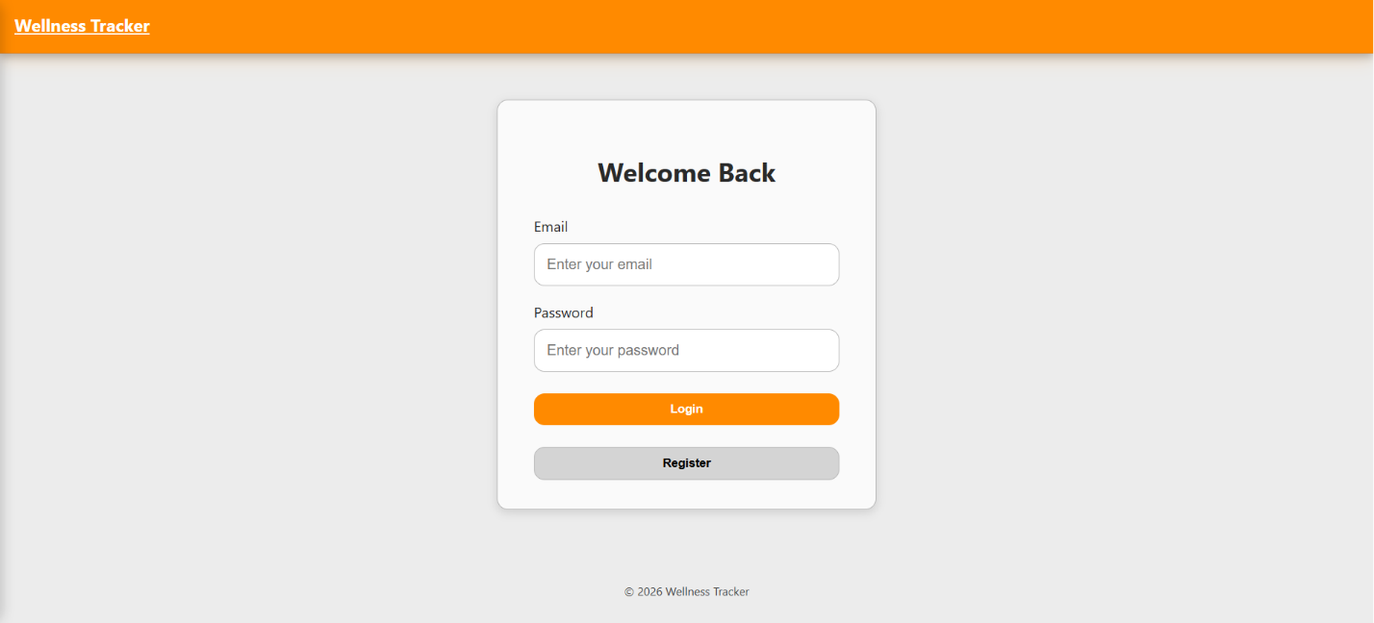
Testing & evaluation
Functional testing
Usability testing
Performance testing
Registration & login
CRUD on all modules
API responses across layers
Navigation flow
Form clarity & labels
Responsive design
API latency
Repeated operations
Mobile responsiveness
KEY INSIGHT
A working interface isn't proof that data is handled correctly — so we tested the full path React → Express → PostgreSQL, including JWT-protected requests.
Source: Hasnain et al. (2021)
Notes:
Presenter: Rajib.
Functional tests covered registration, login, navigation, data entry and CRUD, plus API calls between layers with JWT on protected requests. Usability checks covered readable information, simple forms, clear navigation and responsiveness. Performance checks looked at API latency, repeated operations and mobile responsiveness. The results of the API tests are on the next slide.

Slide 12
Test results
Test case | Expected | Result
Register a new account | 200 + JWT issued | Pass
Log in (email in any letter case) | 200 + JWT issued | Pass
View / update profile goals (blank goal saved as 0) | 200, values saved | Pass
Add, edit and delete an activity | 200, list updated | Pass
Add sleep, hydration and meditation entries | 200, saved per user | Pass
Add appointments; upcoming vs past split | Correct list for each | Pass
Invalid number (e.g. “abc” minutes) | 400 Bad Request | Pass
Edit with required fields missing | 400 Bad Request | Pass
Invalid or expired token | 401 Unauthorized | Pass
Unknown route / malformed JSON | 404 / 400 JSON error | Pass
Startup repair of an old database schema | Columns added, insert works | Pass
API TESTS
11 / 11
test cases passed
Frontend
ESLint: 0 errors across all React and Express files
How we tested
Each request run against the Express API on a fresh PostgreSQL 16 database, then against an old-schema copy to check the startup repair.
Status codes: 200 OK, 400 Bad Request (invalid input), 401 Unauthorized (missing/invalid JWT), 404 Not Found
Notes:
Presenter: Rajib.
These are the API test cases we ran against the Express backend with a fresh PostgreSQL 16 database. All 11 passed. Point out that we tested failure cases too: invalid numbers and missing fields return 400, a bad or expired token returns 401, and unknown routes return a JSON 404. The last row checks the start-up migration against a database with the old table layout — the same problem we hit on Render. ESLint reports no errors across the React and Express code.

Slide 13





Limitations
No admin role
Weekly analytics only
No offline mode
No wearables
Single user type; no admin management
No monthly or long-term trends
Requires a network connection
All data entered manually
The system records and displays health data rather than doing complex health analysis. It runs on free hosting tiers, so the API sleeps when idle and the first request can take 30–60 seconds. Testing with a larger group of real users would surface issues not seen in development.
Notes:
Presenter: Rajib.
Be upfront: there is no admin role, only weekly analytics, no offline mode and no wearable integration. The app records and displays data rather than doing complex health analysis. It is hosted on free tiers, so the API sleeps when idle and the first request after a pause can take 30–60 seconds. It has not yet been tested with a large group of real users.

Slide 14


Future enhancements
Scalability
Always-on hosting
Microservices
Pagination
Security
Rate limiting
Strong password policy
Two-factor auth
Features
Monthly analytics
Goal charts
Reminders
Wearable integration
Source: Janicke et al. (2023)
Notes:
Presenter: Rajib.
Scalability: move to always-on hosting to remove cold starts, consider microservices, and paginate the history pages (the date indexes are already in place). Security: rate limiting, a stronger password policy, two-factor authentication, refresh tokens and httpOnly cookies instead of localStorage. Features: monthly analytics, goal charts, hydration/sleep/meditation/appointment reminders, and wearable integration to cut manual entry.

Slide 15

Conclusion
5
wellness modules
Built and deployed a full-stack wellness tracker
Clean three-tier, modular architecture
3
architecture tiers
Live on Vercel + Render, secure and tested
Clear pathway for future enhancements
7
database tables
Thank you — questions?
Notes:
Presenter: Prasana.
Summarise: a working full-stack tracker covering five modules on a three-tier architecture with seven PostgreSQL tables, deployed live on Vercel and Render, with 11 of 11 API test cases passing. Built collaboratively, secure and accessible, with a clear roadmap. Thank the audience and invite questions.

Slide 16
References
Castilho, R. (2023). Fetch API — Understanding JavaScript API requests and responses in the data fetching lifecycle. https://dev.to/rodcast/fetch-api-understanding-javascript-api-requests-and-responses-in-the-data-fetching-lifecycle-407k
Chen, S., Thaduri, U. R., & Ballamudi, V. K. R. (2019). Front-end development in React: An overview. Engineering International, 7(2), 117–126. https://doi.org/10.18034/EI.V7I2.662
Donham, P. (2017). Using JWTs for authentication in RESTful applications. https://sites.bu.edu/perryd/2017/12/28/using-jwts-for-authentication-in-restful-applications/
Hasnain, M., Pasha, M. F., Ghani, I., & Jeong, S. R. (2021). Functional requirement-based test case prioritization in regression testing: A systematic literature review. SN Computer Science, 2(6), 421. https://doi.org/10.1007/S42979-021-00821-3
Janicke, H., Amine Ferrag, M., Aparicio-Navarro, F. J., Bucko, A., Vishi, K., Krasniqi, B., & Rexha, B. (2023). Enhancing JWT authentication and authorization in web applications based on user behavior history. Computers, 12(4), 78. https://doi.org/10.3390/COMPUTERS12040078
Mamun, A. M. Al. (2021). What is PostgreSQL? Open-source database system. Server Watch. https://www.serverwatch.com/guides/what-is-postgresql/
Urnikiene, J., Steponaviciene, V., & Atanasov, S. (2026). Comparative read performance analysis of PostgreSQL and MongoDB in e-commerce: An empirical study of filtering and analytical queries. Big Data and Cognitive Computing, 10(2), 66. https://doi.org/10.3390/BDCC10020066
Notes:
Reference list (APA 7th) — matches the report.

